Slide 1
WRITING 101
Robin Pawlak

Slide 2
The Plan…
The Nature of Writing
The Nature of People
Implications for Learning & Teaching Writing
Some Ideas

Slide 3
Which of the following statements most resonates with you?
Statement 1
Writing is . . .
Logical
Rational
Linear
Understandable via accepted conventions
Something you get better at by learning rules and acquiring skills

Slide 4
Which of the following statements most resonates with you?
Statement 2
Writing is an inherently creative process by which thoughts, feelings and images are transferred from one person to another. Understood by the heart as much as the mind, it is highly intuitive and primarily navigated by feel.

Slide 5
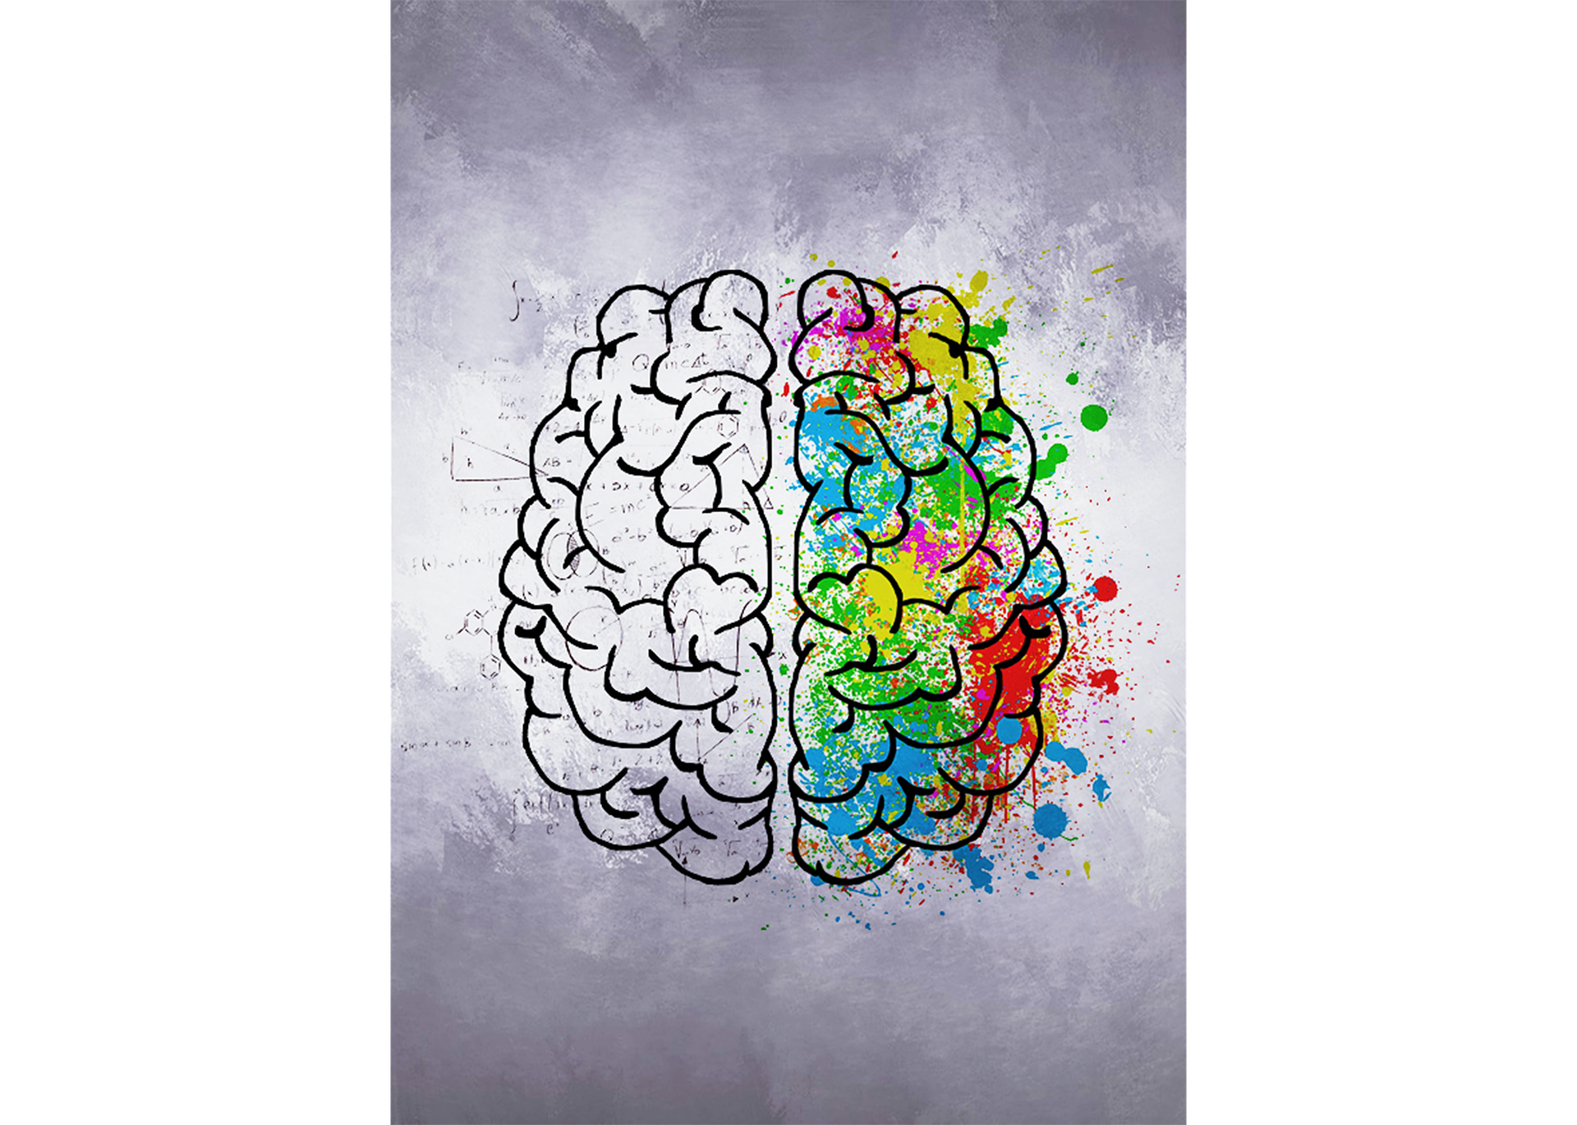
Left Brain vs. Right Brain
Logical
Rational
Linear
Conventions
Rules
Skills
Creative
Thoughts
Feelings
Images
Intuitive
By feel
Image by Léa Latulippe from Pixabay

Slide 6
Logical/Rational & Creative/Intuitive
Logical
Rational
Linear
Conventions
Rules
Skills
Creative
Thoughts
Feelings
Images
Intuitive
By feel
Image by Léa Latulippe from Pixabay

Slide 7
A Simple Formula:
If S = Skills, and F = Forms, and ! = the number of things you need teach your students this year, then…
S X F = !

Slide 8
The Plan…
The Nature of Writing ✔
The Nature of People ✔
Implications for Learning & Teaching Writing
Some Ideas
Sharing, Q & A

Slide 9
Implications for Teaching Writing
Break it down!
Student-driven

Slide 10
Break it Down
As much as possible teach and assess
one thing at a time.

Slide 11
Logical/Rational & Creative/Intuitive

Slide 12
Break it Down
Requires analysis of every writing task:
What skills will they need?
Which ones matter?

Slide 13
Student-Driven
They learn
what they learn
when they’re ready to learn it.

Slide 14
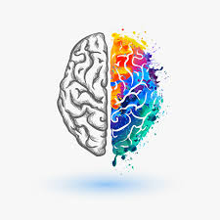
Student-Driven
Humans think & learn
.
in different ways

Slide 15
But . . . how? Some Ideas.
Break it Down
Teach & assess 1 thing at a time
What skills will they need? Which ones matter?
Student-Driven
They learn what they learn when they’re ready to learn it
We think & learn in different ways
Personal Narrative:
Formative
Assessment

Slide 16
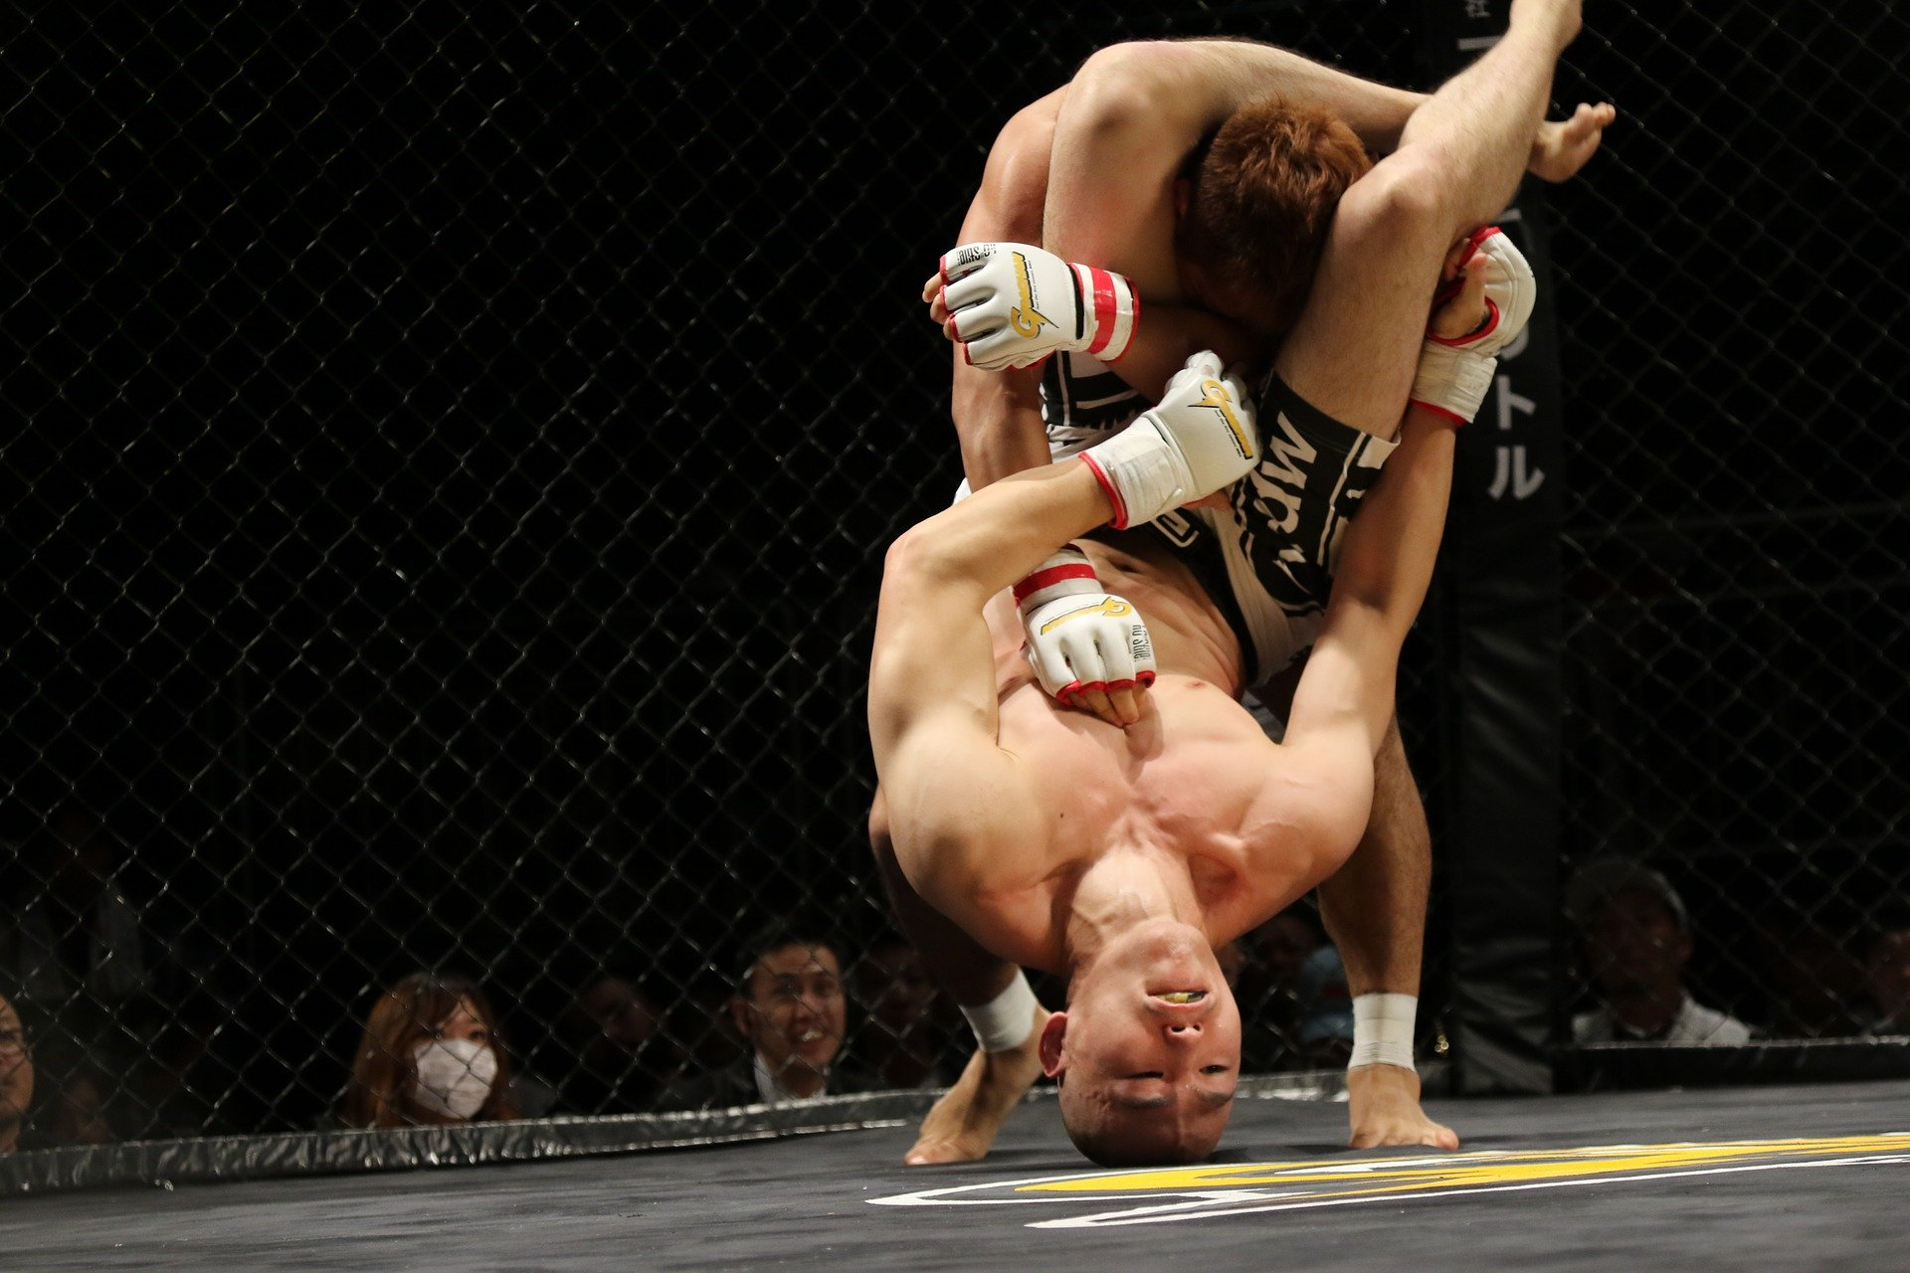
But . . . how? Some Ideas.
Break it Down
Teach & assess 1 thing at a time
What skills will they need? Which ones matter?
Student-Driven
They learn what they learn when they’re ready to learn it
We think & learn in different ways
Social Studies:
Opinion
Paragraph
Image by Mirko Zax from Pixabay

Slide 17
But . . . how? Some Ideas.
Break it Down
Teach & assess 1 thing at a time
What skills will they need? Which ones matter?
Student-Driven
They learn what they learn when they’re ready to learn it
We think & learn in different ways
Social Studies:
Opinion
Paragraph
Image by Mirko Zax from Pixabay

Slide 18
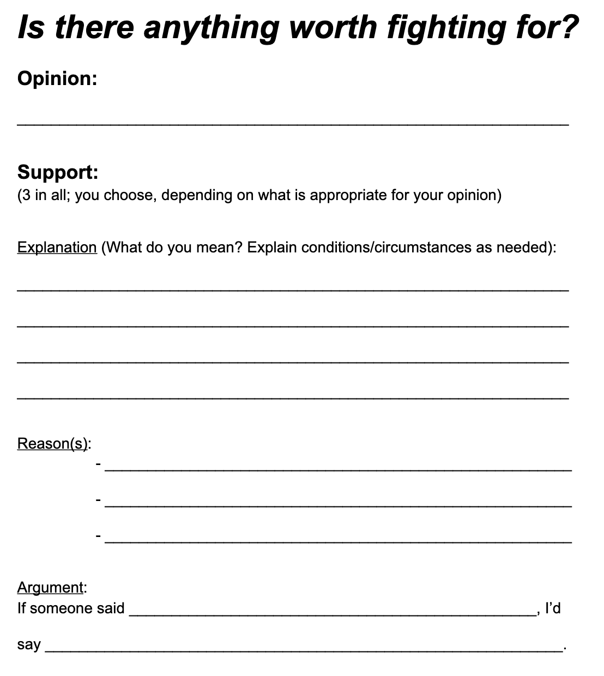
But . . . how? Some Ideas.
Break it Down
Teach & assess 1 thing at a time
What skills will they need? Which ones matter?
Student-Driven
They learn what they learn when they’re ready to learn it
We think & learn in different ways
Social Studies:
Opinion
Paragraph

Slide 19
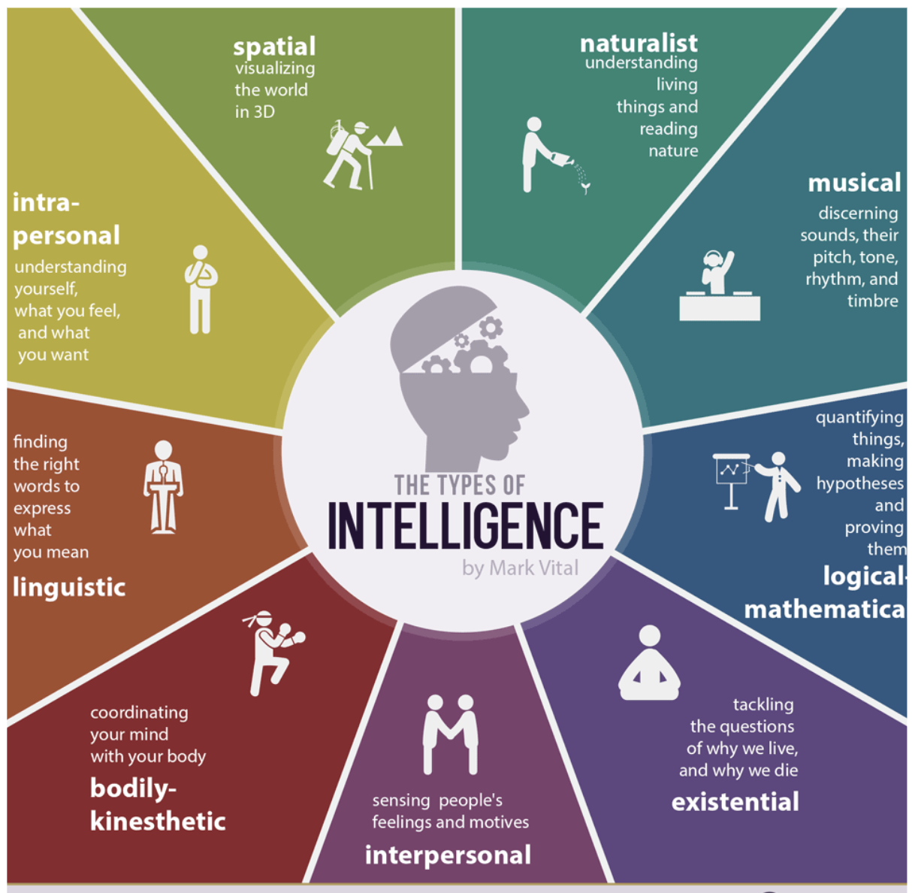
But . . . how? Some Ideas.
Break it Down
Teach & assess 1 thing at a time
What skills will they need? Which ones matter?
Student-Driven
They learn what they learn when they’re ready to learn it
We think & learn in different ways
Creative Writing:
How to Get Your
Students Writing

Slide 20
But . . . how? Some Ideas.
Creative Writing:
Break it Down
Teach & assess 1 thing at a time
What skills will they need? Which ones matter?
Student-Driven
They learn what they learn when they’re ready to learn it
We think & learn in different ways

Slide 21
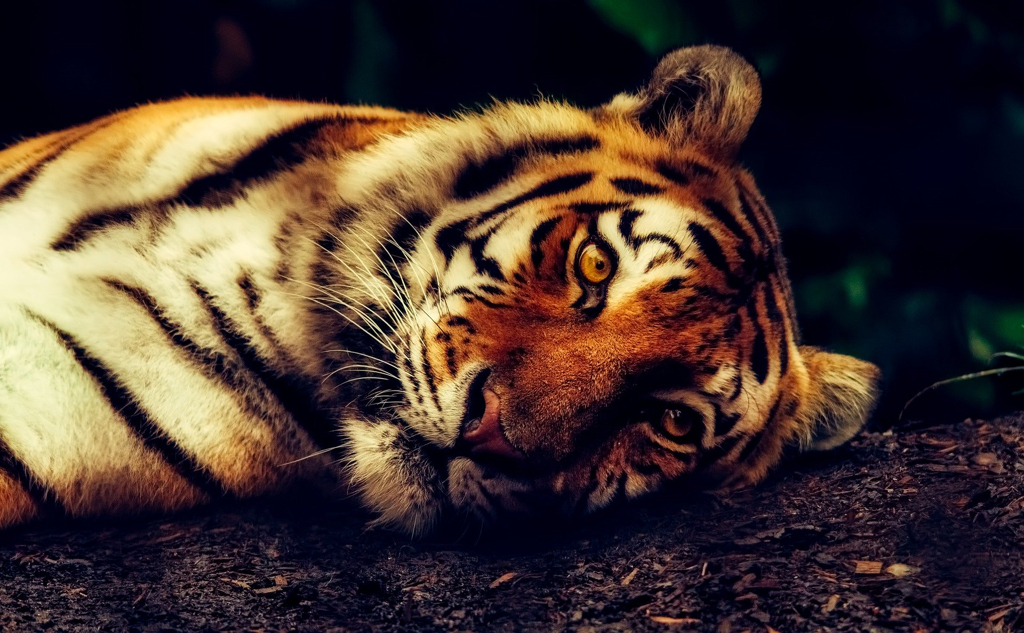
But . . . how? Some Ideas.
Break it Down
Teach & assess 1 thing at a time
What skills will they need? Which ones matter?
Student-Driven
They learn what they learn when they’re ready to learn it
We think & learn in different ways
Science Report:
Animals
Image by David Mark from Pixabay

Slide 22
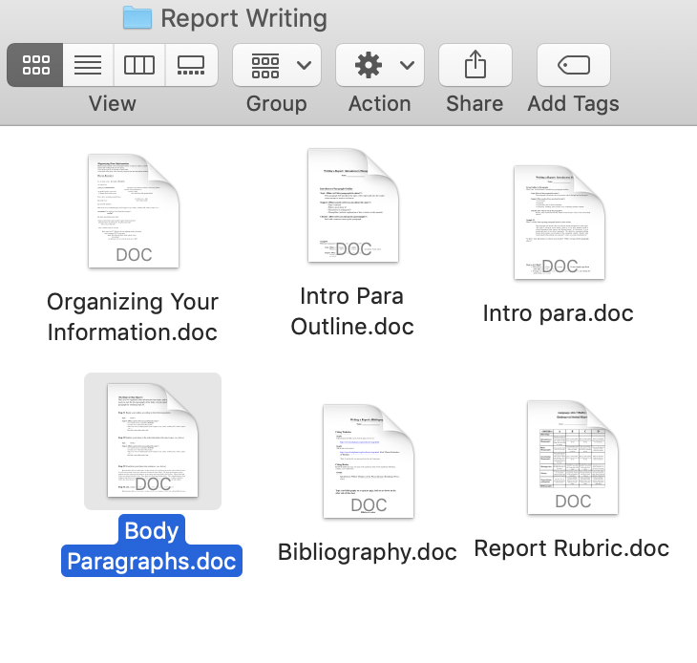
But . . . how? Some Ideas.
Break it Down
Teach & assess 1 thing at a time
What skills will they need? Which ones matter?
Student-Driven
They learn what they learn when they’re ready to learn it
We think & learn in different ways
Science Report:
Animals
Image by David Mark from Pixabay

Slide 23
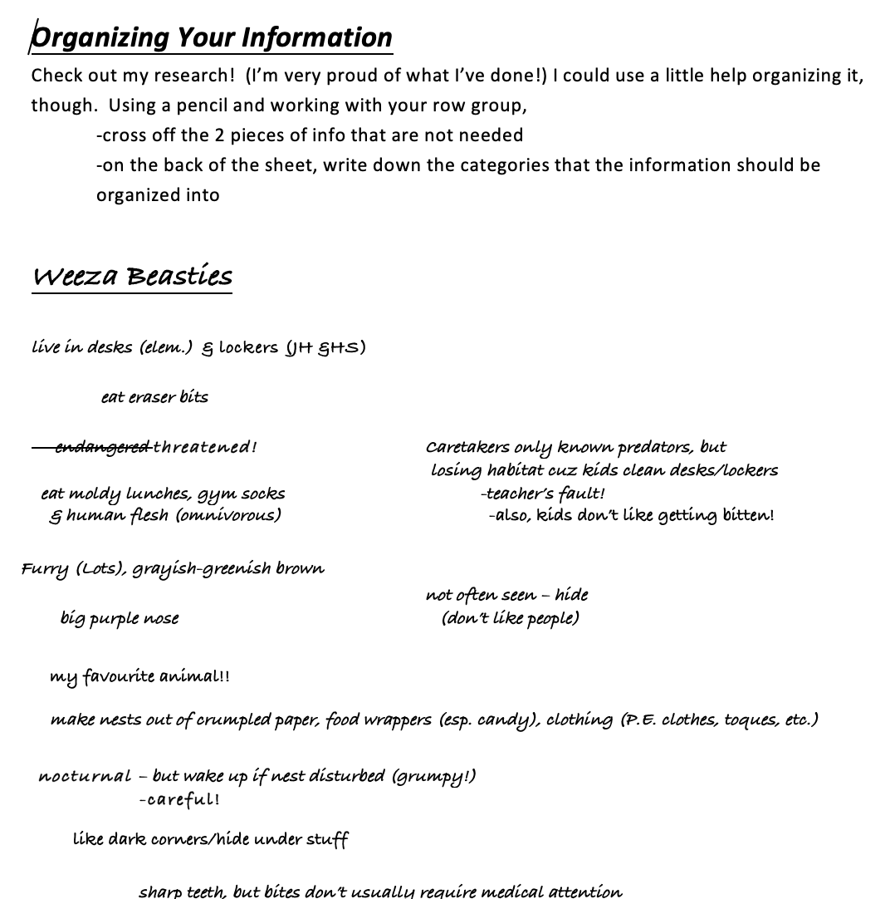
But . . . how? Some Ideas.
Break it Down
Teach & assess 1 thing at a time
What skills will they need? Which ones matter?
Student-Driven
They learn what they learn when they’re ready to learn it
We think & learn in different ways
Science Report:
Animals
Image by David Mark from Pixabay

Slide 24
Implications for Teachers Improving their Practice
Break it down!
Student-driven
You’re the student!

Slide 25
Thanks!
Connect with me at
robinpawlak.com
We can also connect on Twitter (@1robinstweet)
or Facebook/Instagram (1robinpawlak)

